Slide 1
5. Audio coding standards
Xavier Serra

Slide 2
Index
MIDI vs Audio
Mono, Stereo and Surround Sound formats
MPEG audio standards
MPEG-1 Layer 3 (MP3)
MPEG-2 Advanced Audio Coding (AAC)
MPEG-4
Dolby Digital (AC3)
Lossless audio coding

Slide 3
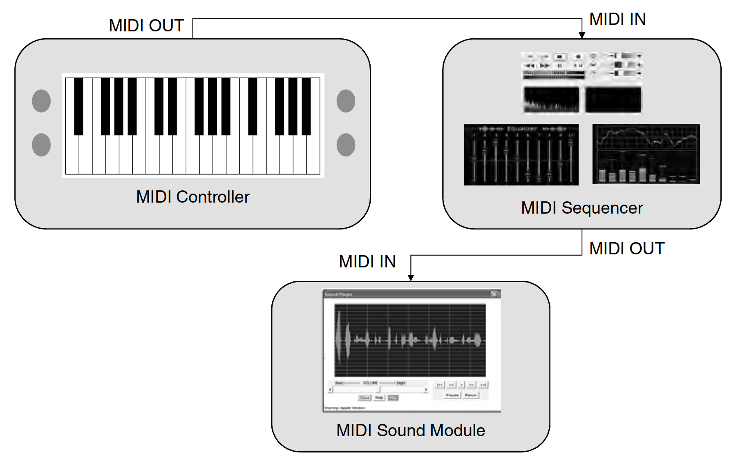
MIDI

Slide 4
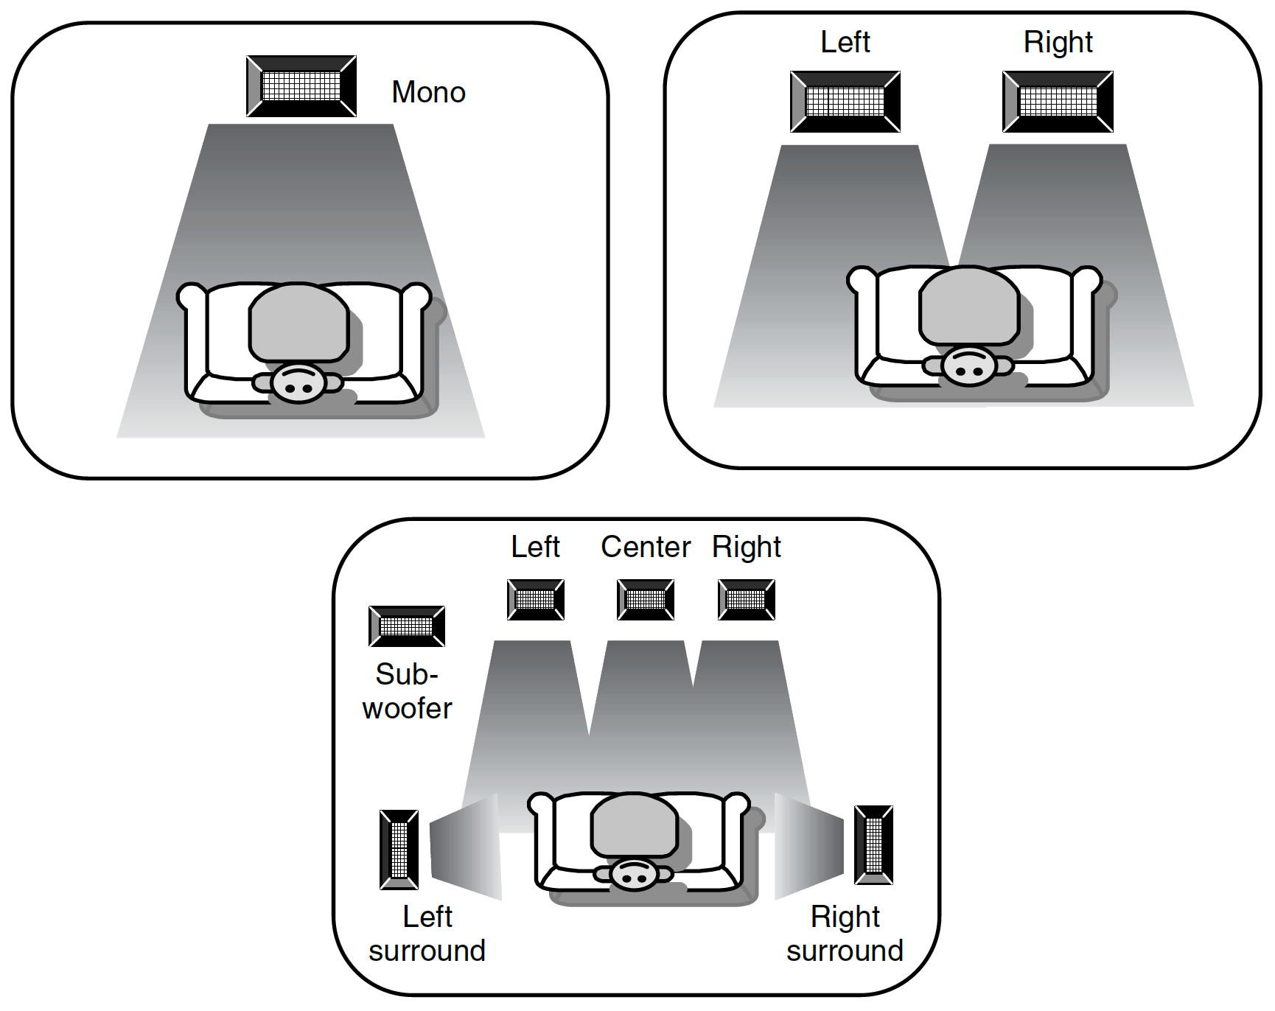
Mono, Stereo, Surround

Slide 5
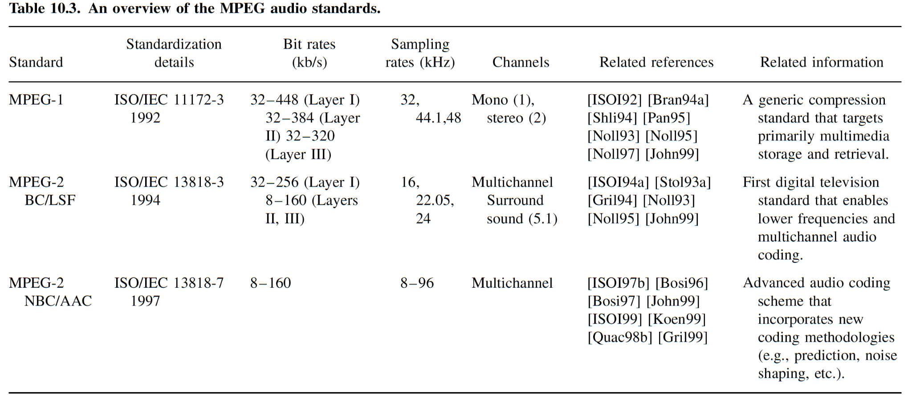
MPEG audio standards
MPEG is the acronym for Moving Pictures Experts Group
MPEG standardizes the type of information that an encoder has to produce as well as the way in which the decoder has to decompress the information

Slide 6
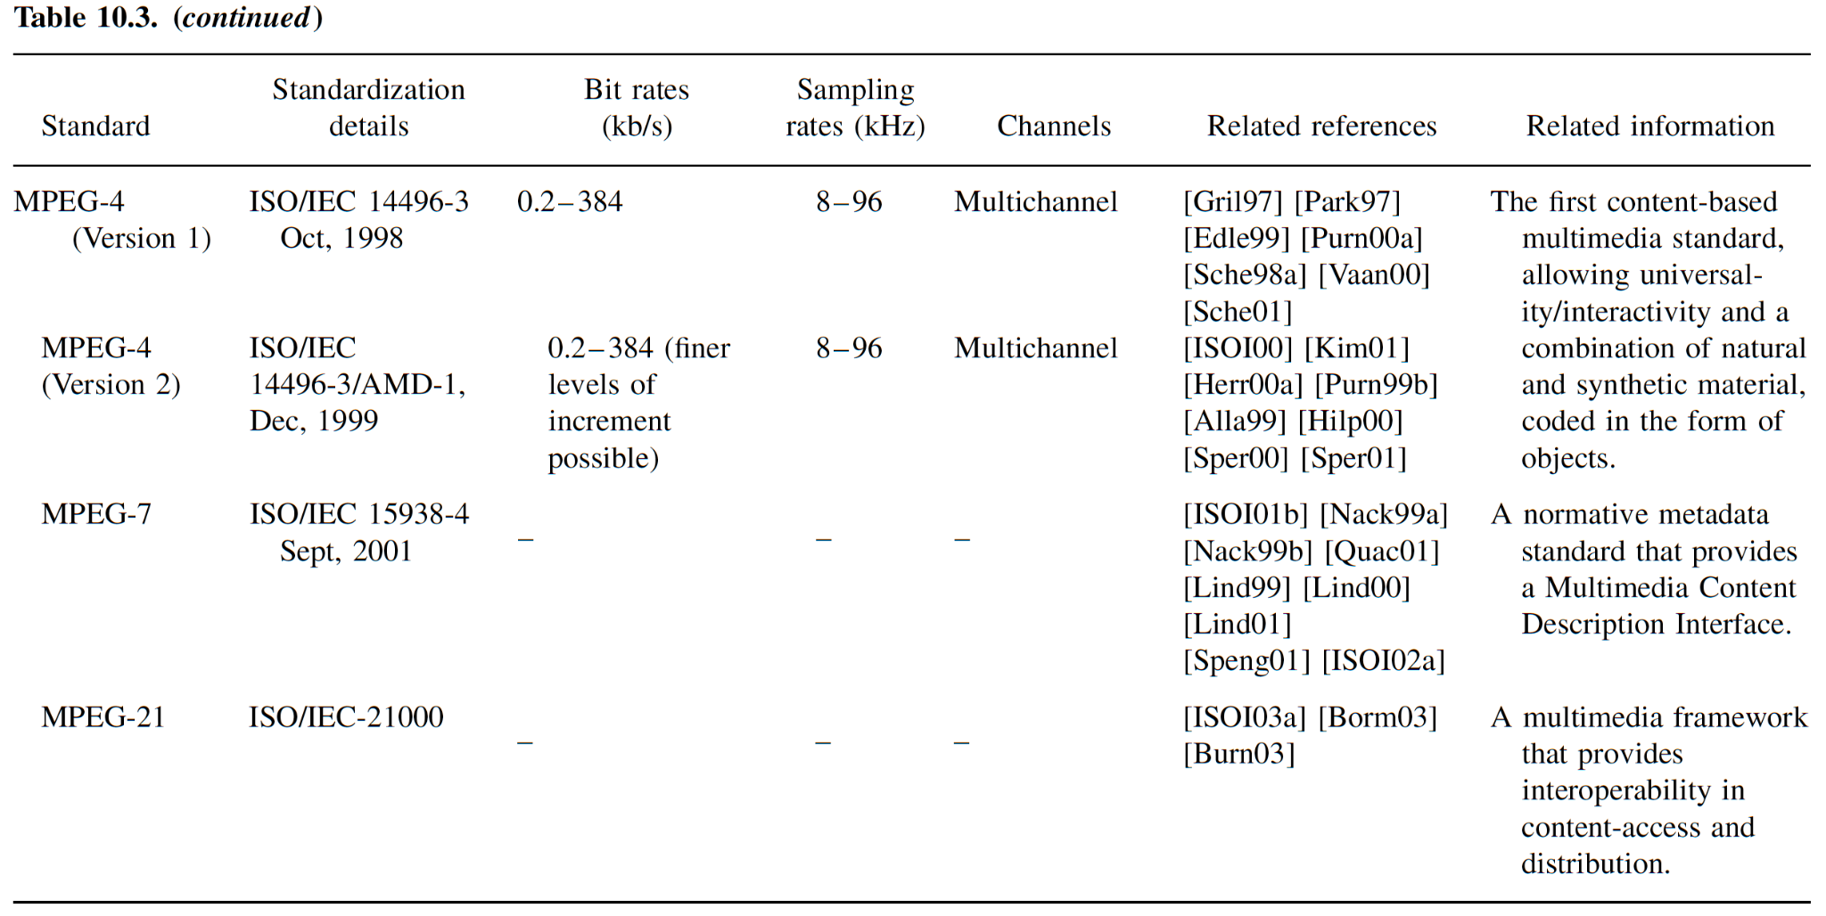

Slide 7
MPEG-1 Audio
Lossy compression of mono and stereo signals
Sampling frequency: 32KHz, 44.1 KHz, 48 KHz
Precision 16 bits
3 compression layers: Layer 1, Layer 2, Layer 3
Layer 1: 32-448 kbps, target 192 kbps
Layer 2: 32-384 kbps, target 128 kbps
Layer 3: 32-320 kbps, target 64 kbps
Layer 3 is called MP3 format
Popular for Internet applications

Slide 8
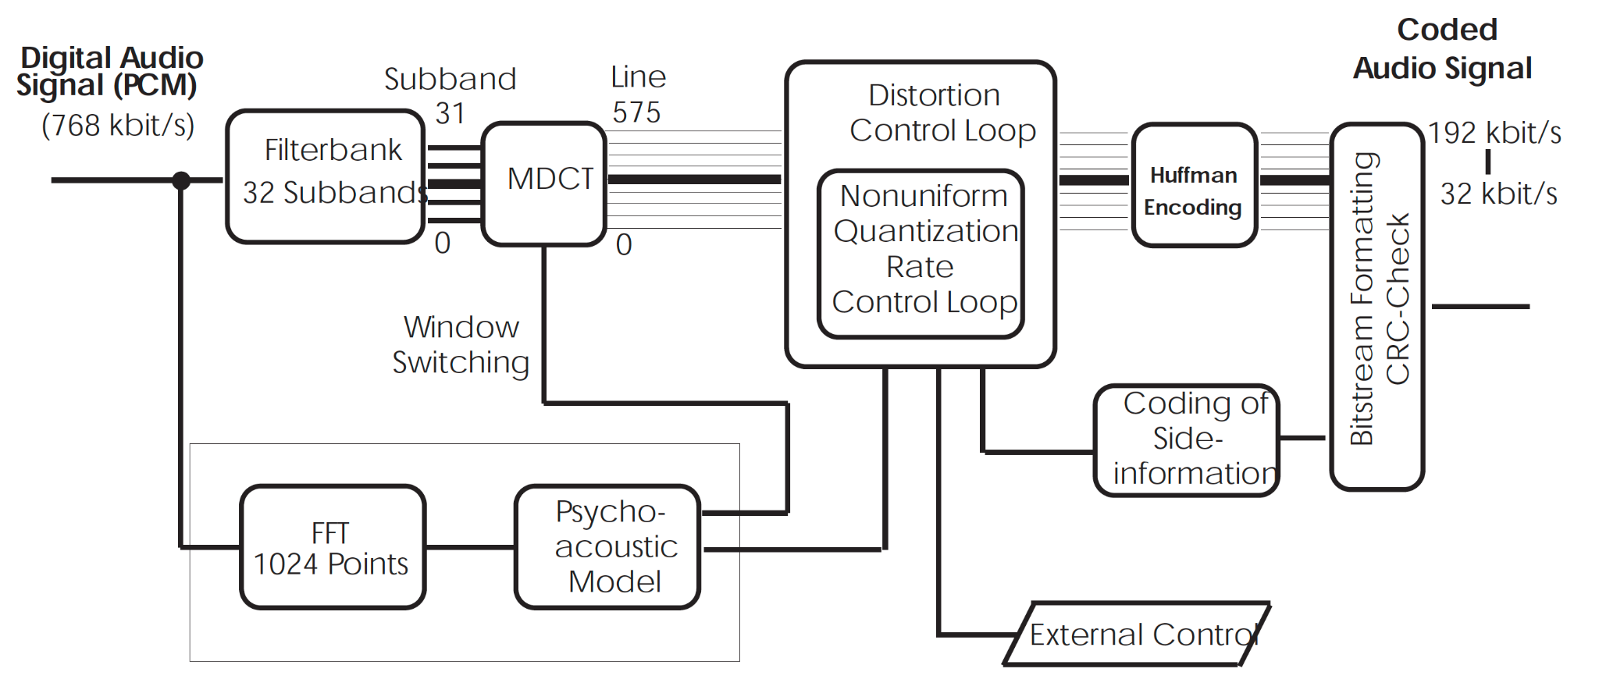
MP3 encoder

Slide 9
Filter bank: Hybrid filter bank. Polyphase filterbank (as used in Layer-1 and Layer2) followed by a Modified Discrete Cosine Transform (MDCT).
Perceptual model to identify masking thresholds based on critical bands of human hearing and using the FFT.
Quantization and coding: Two nested iteration loops. Use of Huffman coding.

Slide 10
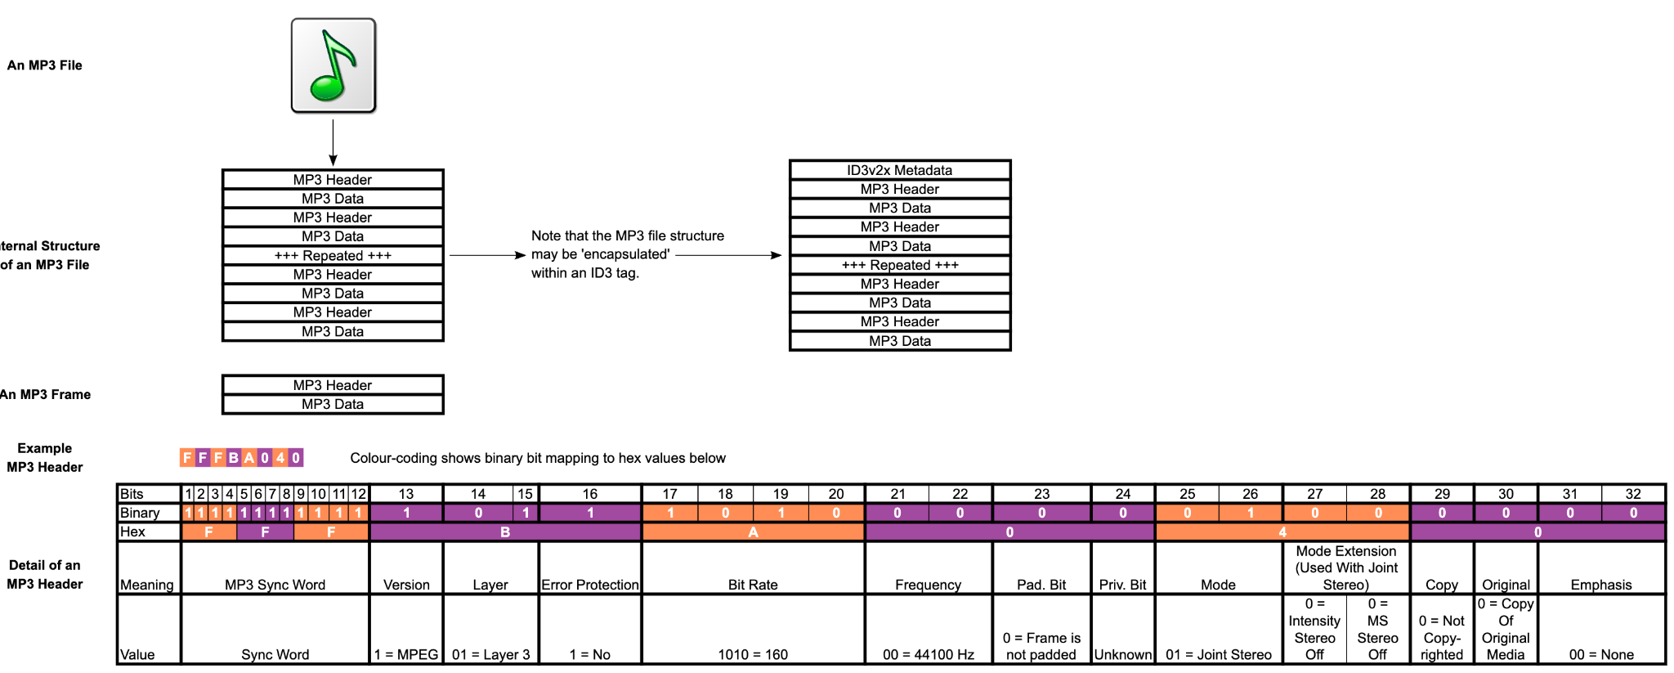
MP3 audio format

Slide 11
MPEG-2 Advanced Audio Coding (AAC)
Supports up to 5.1 channels
AAC follows the same basic coding paradigm as Layer-3 (high frequency resolution filterbank, non-uniform quantization, Huffman coding, iteration loop structure using analysis-by-synthesis), but improves on Layer-3 in a lot of details and uses new coding tools for improved quality at low bitrates.
Higher frequency resolution (1024 frequency lines)
Improved joint stereo coding
Improved Huffman coding
Enhanced block switching
…

Slide 12
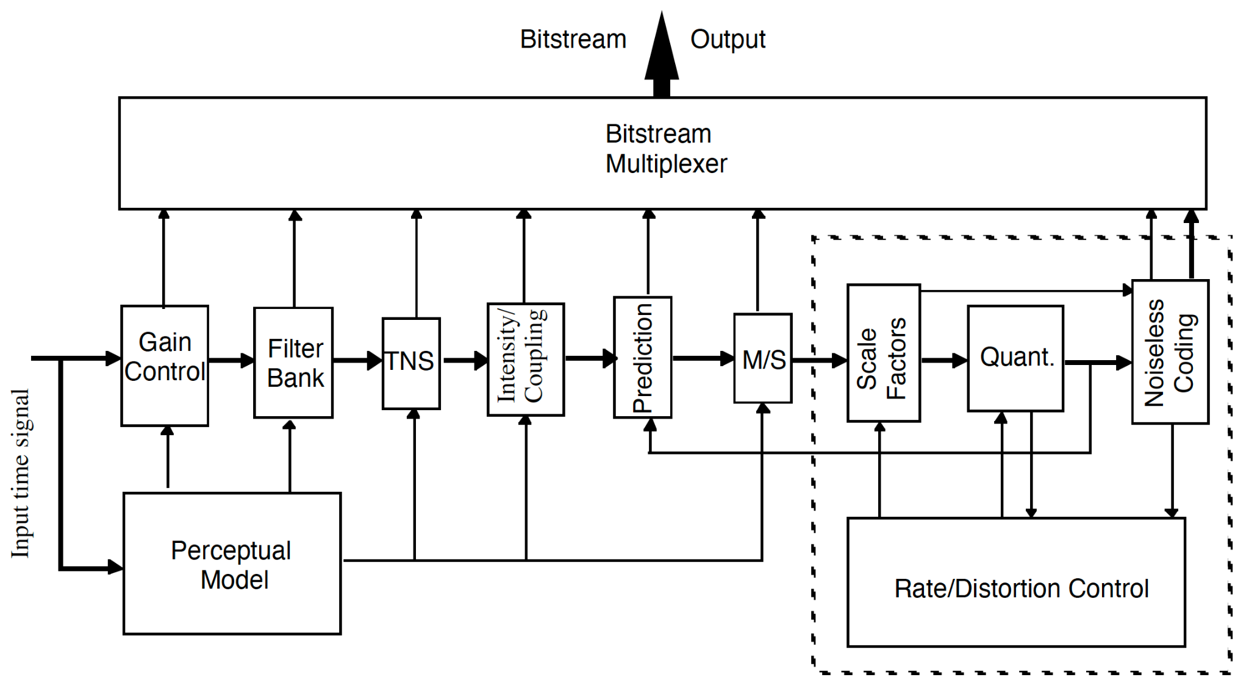
AAC encoding

Slide 13
Temporal noise shaping (TNS) tool helps to control temporal shape of quantization noise.
Intensity coding and the coupling reduces perceptually irrelevant information by combining multiple channels in high-frequency regions into a single channel.
Prediction tool further removes redundancies between adjacent frames.
M/S coding removes stereo redundancy based on coding the sum and difference signal instead of the left and right channels.

Slide 14
MPEG-4 Audio
Extensive scalability and object-based representations
Variety of applications
General audio signals
Speech signals
Synthetic audio
Synthesized speech (structured audio)
More sample frequencies (8-96 kHz)
Arbitrary bit rates and variable frame length
Higher efficiency and simpler filterbank
Uses pure MDCT (modified discrete cosine transform)
Used in Windows Media Audio

Slide 15
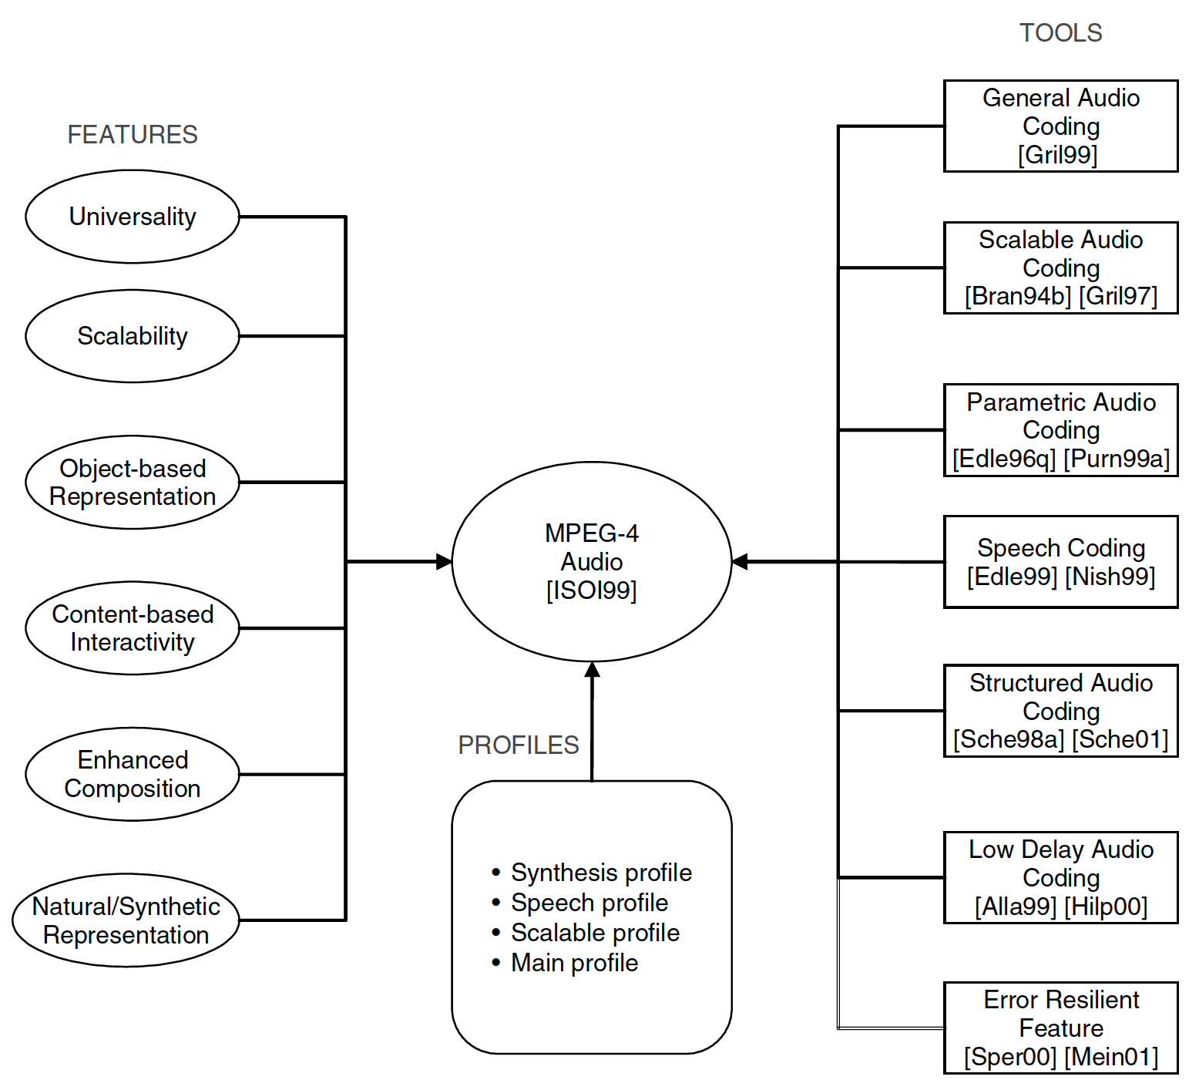

Slide 16
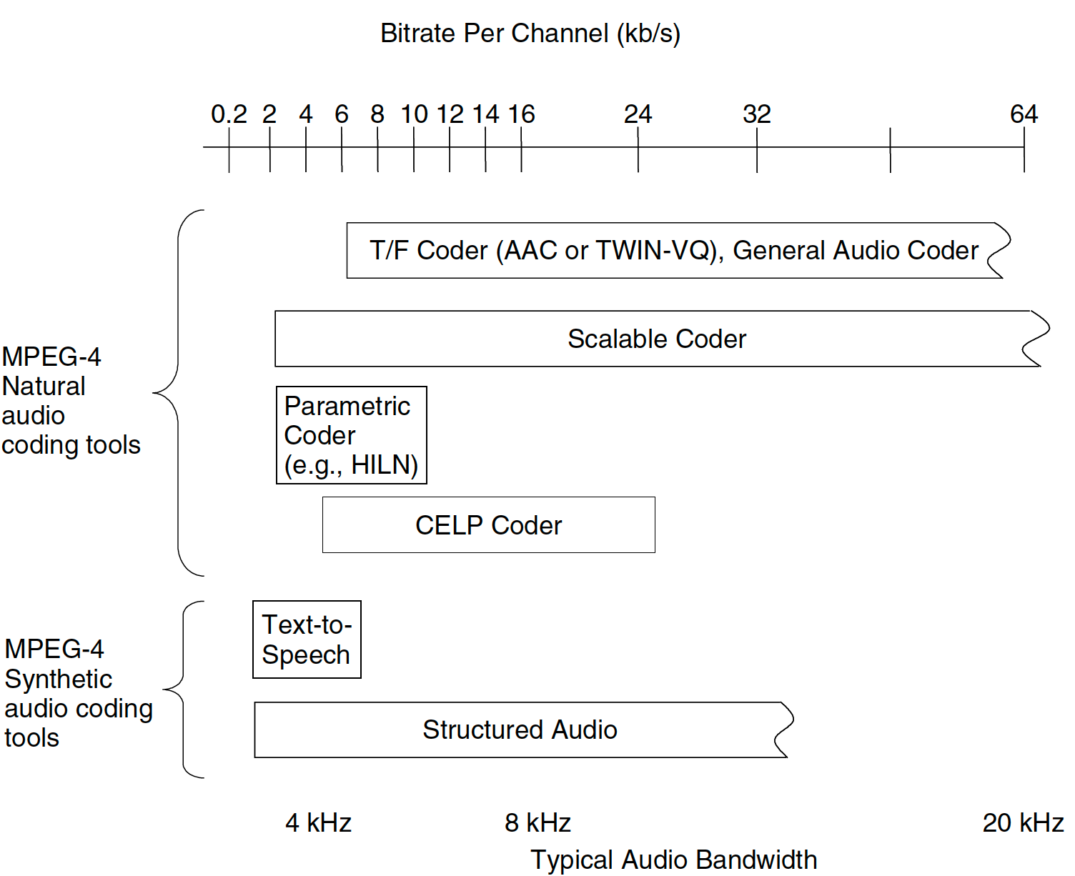
MPEG-4 integrated tools

Slide 17
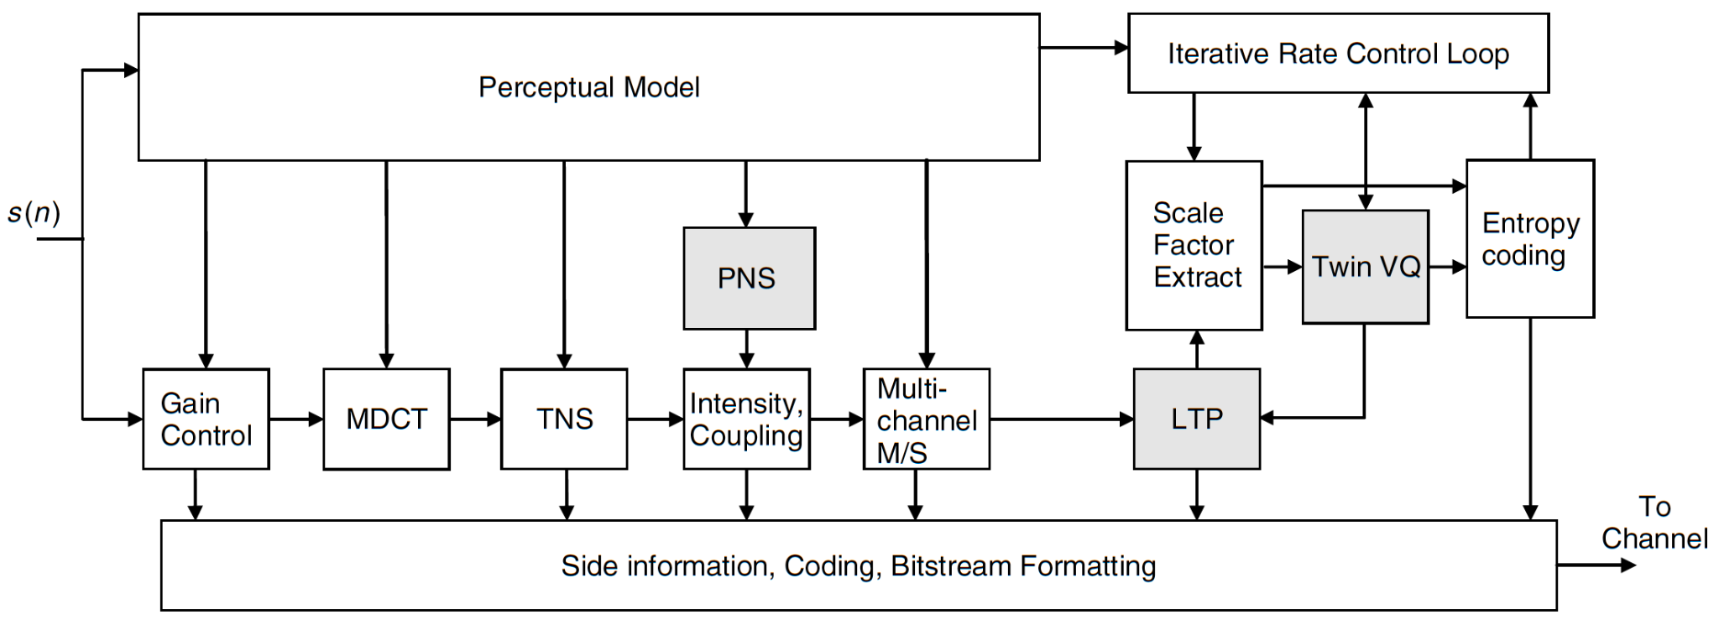
MPEG-4 General Audio coder

Slide 18
Built around MPEG-2 AAC
Extended features and coder configurations given by the perceptual noise substitution (PNS), long term predictions (LTP), Twin VQ coding, and scalability.

Slide 19
MPEG-4 Twin VQ in GA coder
Called MP4 with Extension .mp4
Multimedia container format
Stores digital video and audio streams and allows streaming over Internet
Container or wrapper format
meta-file format whose spec describes how different data elements and metadata coexist in computer file

Slide 20
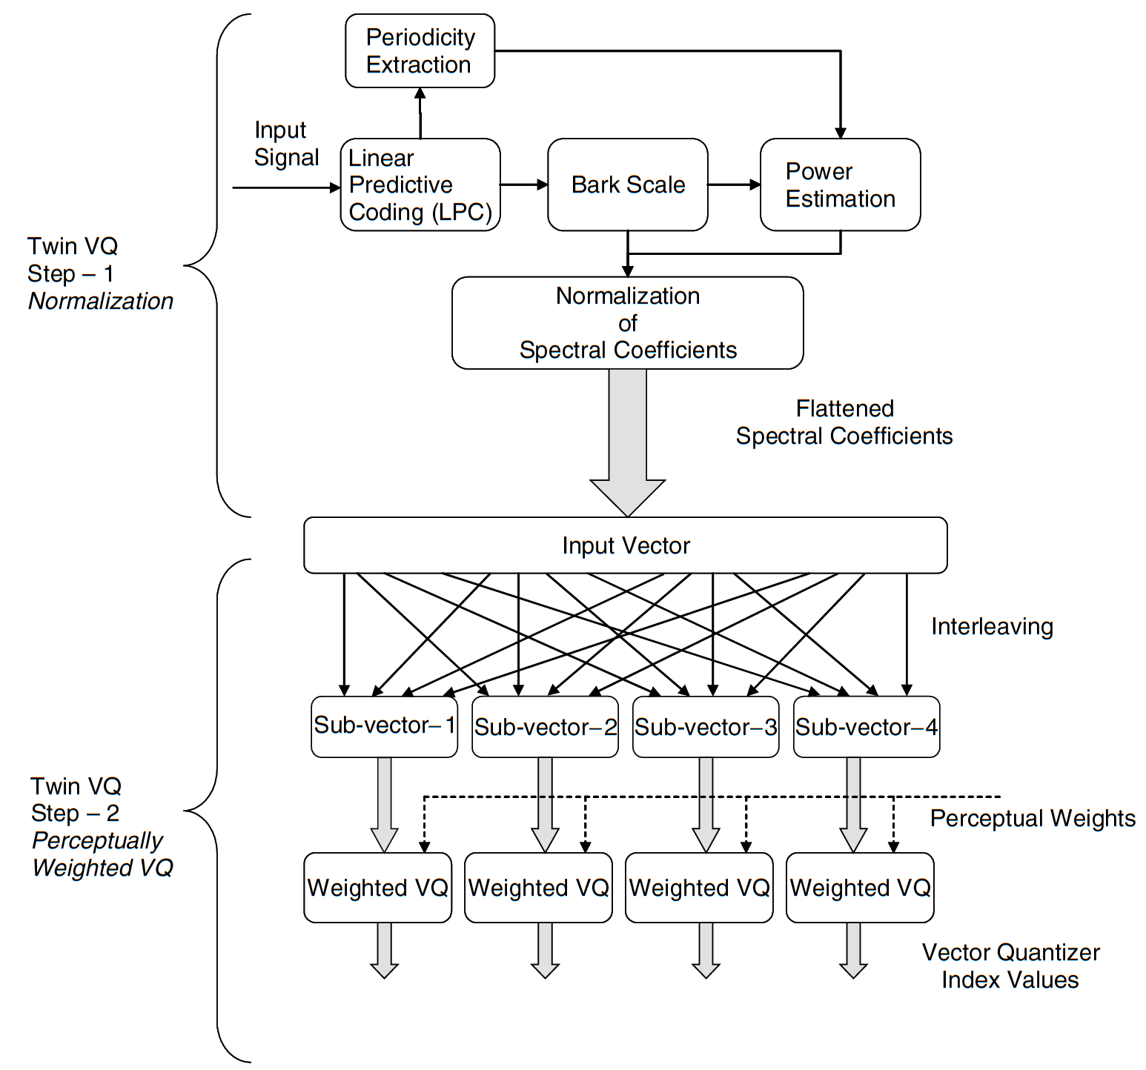
MPEG-4 Twin VQ in GA coder

Slide 21
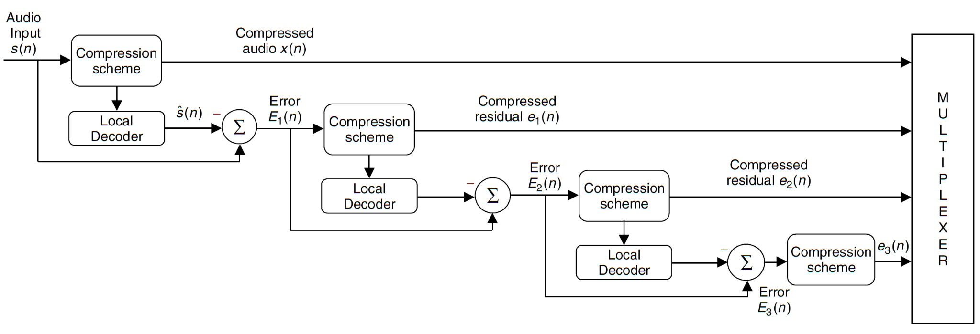
MPEG-4 Scalable audio coding

Slide 22
Dolby AC-3 (Dolby Digital)
Sample rates: 32, 44.1, and 48 kHz
Bit rates: 32–640 kb/s, variable
High-quality output at 64 kb/s per channel
Delay roughly 100 ms
Multiple channels processed as an ensemble
Robust decoder downmix functionality from 5.1 to fewer channels

Slide 23
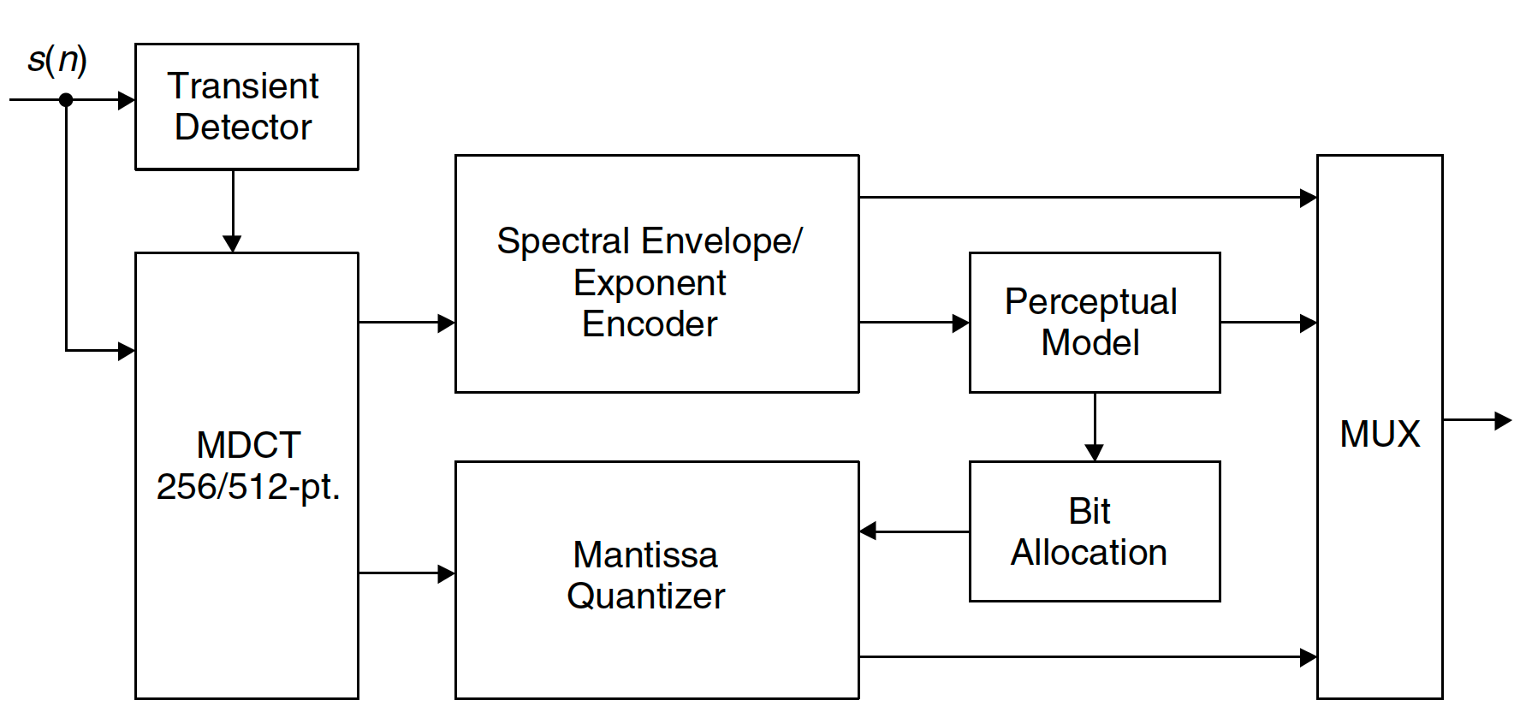
Dolby Digital encoder

Slide 24
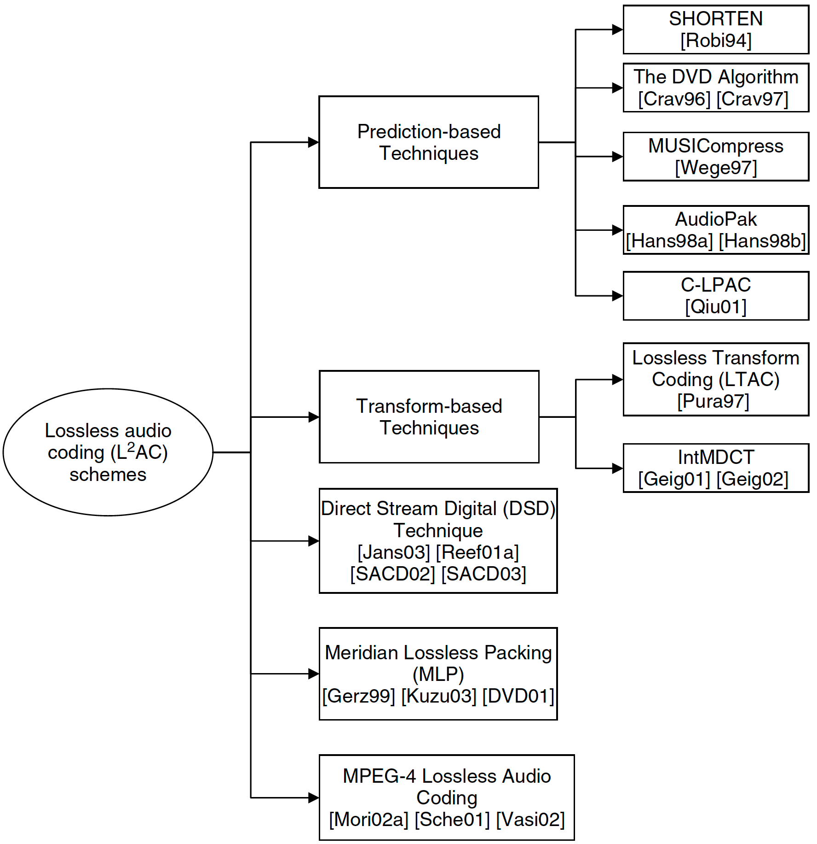
Lossless Audio coding algorithms

Slide 25
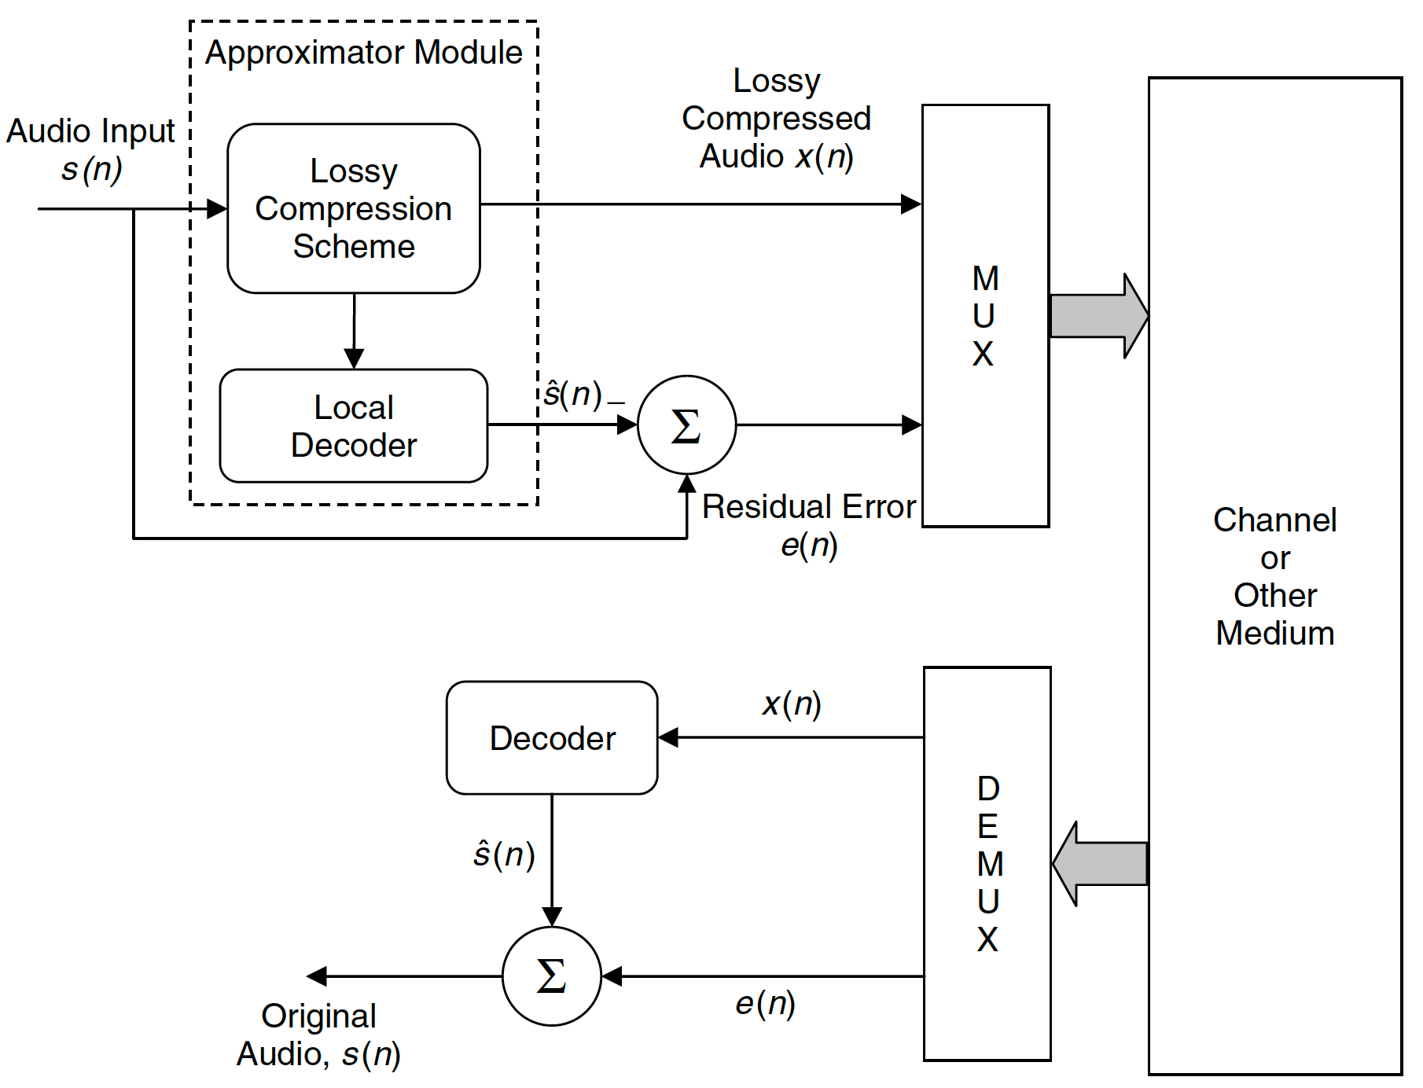
Lossless audio based on lossy audio scheme

